Slide 1

Health Insurance Cross Sell Prediction
GROUP 6
IST-718
By
Aatish Suman
Adheesh Phadnis
Sharvil Turbadkar
Snehal Ghatpande

Slide 2
Project Overview
The objective of the project is to build a model to predict whether the policyholders from the past year will also be interested in purchasing vehicle insurance provided by the company.
It would be extremely helpful for the company.
It can aid the company to plan its communication strategy to reach out to those customers and optimize its business model and revenue.
To predict whether the customer would be interested in Vehicle insurance we are using the data about the demographics (gender, age, region code type), vehicles (age, damage), policy (premium, sourcing channel), etc.

Slide 3
Data Description
The data set is of Health Insurance Cross Sell Prediction.
The data set consists of 508,146 rows and 12 columns.
Source of the dataset – https://www.kaggle.com/anmolkumar/health-insurance-cross-sell-prediction

Slide 4
Data Description
Variable | Definition
id | Unique ID for the customer
Gender | Gender of the customer
Age | Age of the customer
Driving_License | 0: Customer does not have DL, 1: Customer already has DL
Region_Code | Unique code for the region of the customer
Previously_Insured | 1: Customer already has Vehicle Insurance, 0: Customer doesn't have Vehicle Insurance
Vehicle_Age | Age of the Vehicle
Vehicle_Damage | 1: Customer got his/her vehicle damaged in the past, 0: Customer didn't get his/her vehicle damaged in the past.
Annual_Premium | The amount customer needs to pay as premium in the year
Policy_Sales_Channel | Anonymized Code for the channel of outreaching to the customer i.e. Different Agents, Over Mail, Over Phone, In Person, etc.
Vintage | Number of Days, Customer has been associated with the company
Response | 1: Customer is interested, 0: Customer is not interested

Slide 5
Prediction and Inference Goals
Use linear regression to understand the relationship between different variables and estimate their predictive power for determining whether the customer is interested in purchasing vehicle insurance.
Use the Naïve Bayes, SVM, Random forests, Gradient-boosted trees-based classifiers along with logistic regression and neural networks to predict whether a current policyholder would be interested in purchasing vehicle insurance from the company using customer demographics, vehicle properties, and policy.

Slide 6
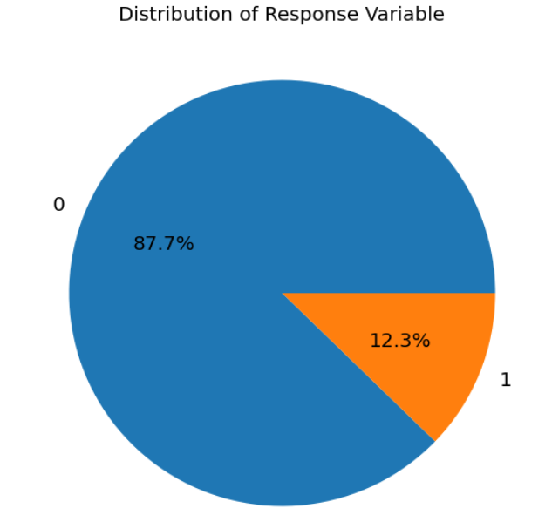
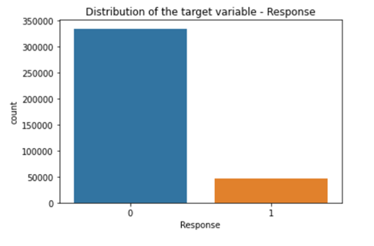
Target variable
Response – whether the customer is interested in vehicle insurance or not
Target is heavily imbalanced as many customers as a result

Slide 7
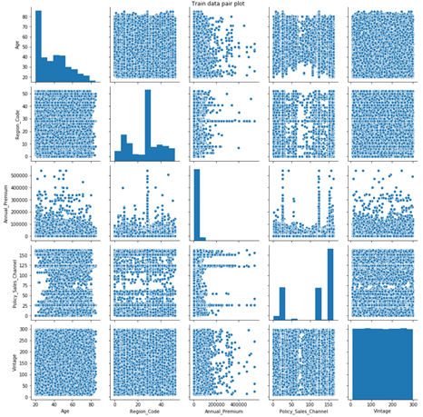
Data Exploration
There doesn't seem to be any correlation between the variables Age, Region_Code, Annual_Premium, Policy_Sales_Channel and Vintage as can be seen from the pair plots.

Slide 8
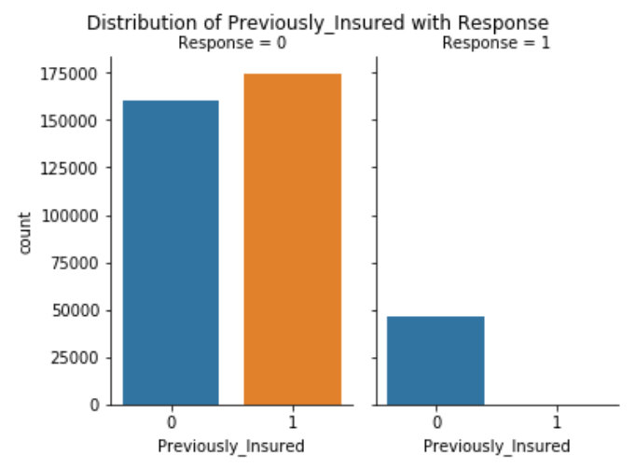
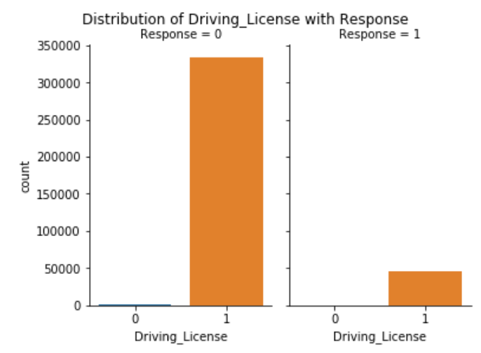
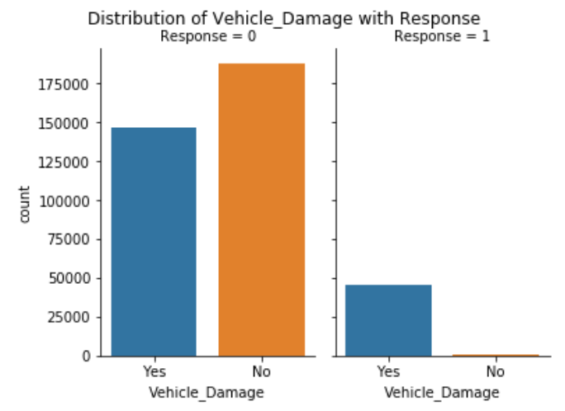
Data Exploration
All interested customers (Response=1) have a driving license (Driving_License=1) and already have a vehicle insurance (Previously_Insured=1), and almost all of them have damaged their vehicle in the past (Vehicle_Damaged=Yes) (shown in the categorical plot below).
The 3 variables have high predictive power.

Slide 9
Feature selection
Variable | Linear regression p-values | Random forest feature importance
Vehicle_Damage | 0.000000e+00 | 0.419990
Age | 0.000000e+00 | 0.280382
Policy_Sales_Channel | 0.000000e+00 | 0.140696
Vehicle_Age | 0.000000e+00 | 0.079464
Previously_Insured | 0.000000e+00 | 0.075979
Region_Code | 2.226673e-01 | 0.003271
Vintage | 9.445091e-01 | 0.000178
Annual_Premium | 0.000000e+00 | 0.000040
Gender | 1.432632e-12 | 0.000000
Driving_License | 0.000000e+00 | 0.000000
Linear regression step-wise selection based on p-value and MSE
Starting with all variables measure the MSE
Sort the variables by p-values and remove the one with the highest p-value
Measure the MSE and check if there’s an improvement
Yes -> remove the variable, no -> use the current list
Vehicle_Damage, Vehicle_Age, Previously_Insured, Driving_License, Policy_Sales_Channel, Annual_Premium, Age
Random forest feature importance

Slide 10
Methods and Results
Algorithm | Accuracy | PR AUC score
NB | 0.6809 | 0.1602
Linear SVM | 0.8781 | 0.2948
Logistic regression | 0.8752 | 0.3383
Random forest | 0.8783 | 0.356
Gradient-boosted tree | 0.8764 | 0.3557
Decision tree | 0.877 | 0.3122
Neural network | 0.8774 | 0.4999
Majority vote baseline | 0.8774

Slide 11
Problems encountered
Problems:
Skewed Response variable
Feature selection
Feature engineering strategies
Possible Solutions:
SMOTE(synthetic minority oversampling technique)/Oversampling
Examination of cross frequency distribution
Experiment with binning

Slide 12
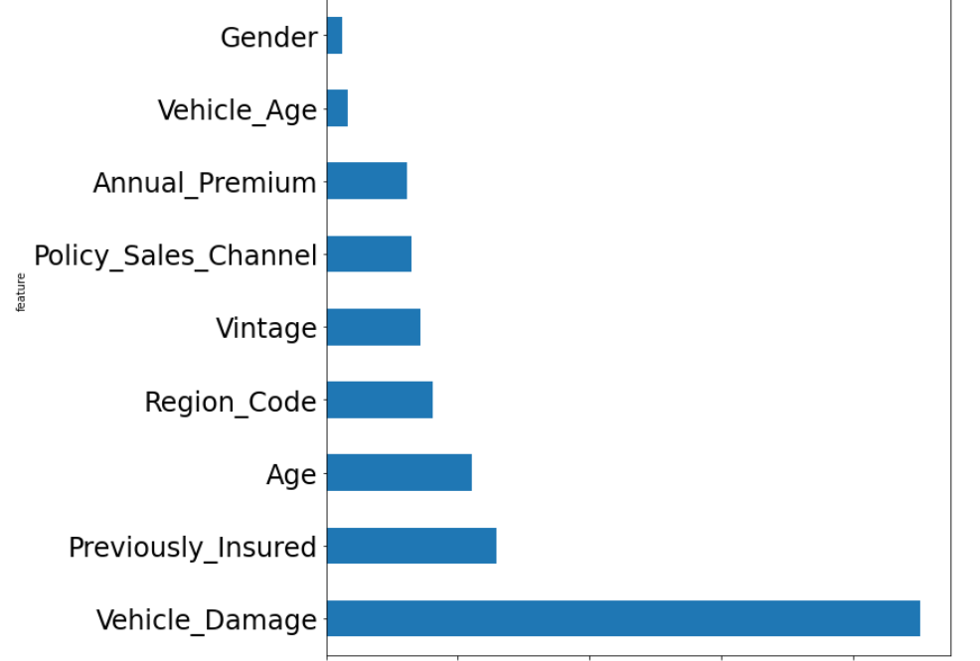
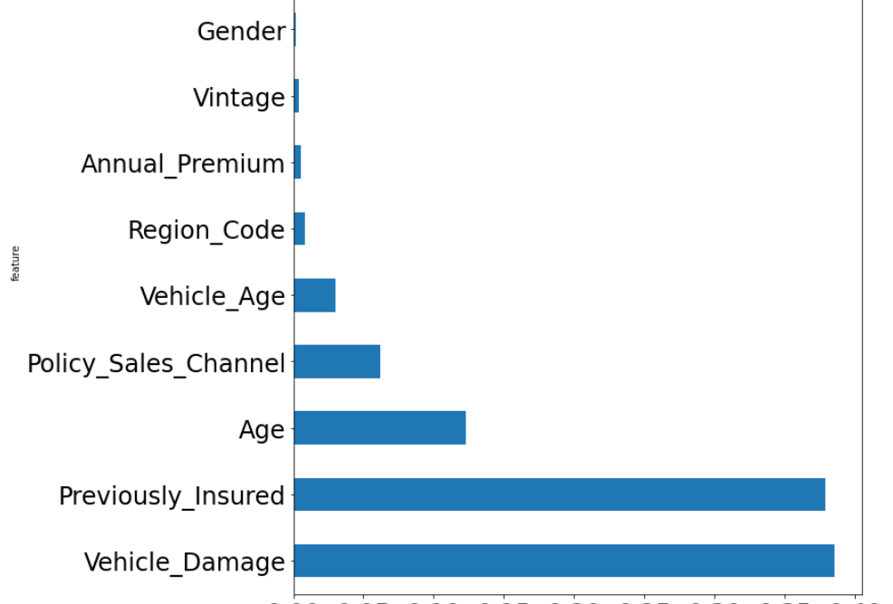
Feature Importance
Gradient Boosting
Random Forest

Slide 13
Inferences
From the feature importance that was implemented, the top features were found to be Vehicle_Damage, Vehicle_Age, Previously_Insured, Driving_License, Policy_Sales_Channel, Annual_Premium and Age which influence the policyholders’ decision to purchase vehicle insurance.
From all the models, Vehicle_Damage was found to be the most important feature and it makes sense as the damage to a vehicle plays a key role in a person’s decision towards purchasing vehicle insurance.
We can also infer that higher value of Vehicle_Age results in a higher chance of policyholders’ decision to purchase vehicle insurance. Auto insurance for old cars is often cheaper due to their low resale value and also because they can cut back on certain “add-on insurances”.

Slide 14
Recommendations
1. Personalized marketing
From the feature importance it is clear that people who have vehicles damaged in the past are interested in buying in vehicle insurance. But the company can look at it the other way and reach out to the customers who do not have damaged vehicles too, inducing the need to buy the insurance. This will largely contribute to the rates of the insurance company.
2. Offer discounts
Customers with cars purchased within 2 years are less likely to buy vehicle insurance. To make the cross selling of vehicle insurance more enticing to them, the company can introduce discounts to these customers based on their annual premium amount.
3. Educate the customers
The customers who previously did not have vehicle insurance but have a valid driving license can be made aware of the benefits of owning vehicle insurance. The company can leverage this strategy to increase its cross sell.

Slide 15
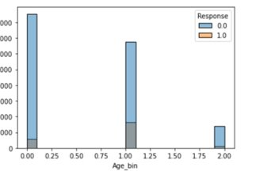
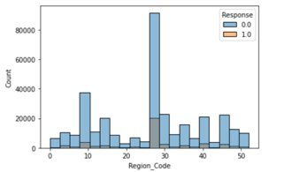
Recommendations
4. Geographic segmentation
There is a high number of customers from region 28. These customers can be targeted for advertising the vehicle insurance, since they might have similar lifestyles or needs being from the same region.
5. Age demographic
People in the age range of 35-65 years are more likely to purchase vehicle insurance. The company can target these customers along with the customers younger than 35 for advertising the vehicle insurance policy.

Slide 16
Group member contribution
Aatish: Exploratory Data Analysis, Feature engineering, Naïve Bayes, Support Vector Machine
Adheesh: Project Proposal, Logistic Regression, Recommendations
Sharvil: Visualizations, Decision Trees, Random Forest, Gradient Boosting
Snehal: Project Proposal, Neural Network, PowerPoint presentation, Recommendations

Slide 17

THANK YOU! ANY QUESTIONS?

